Slide 1
3
RPi and IoT, Firebase
Download materials here!
http://bit.ly/wk5-download

Slide 2
Date: 16 June 2019
Instructor Name: Yuxuan, Jason
Objectives:
Revise Week04 RPi circuit
Learn how to set up Google Firebase
Connect Google Firebase using Python
[Bonus] Python Flask & App

Slide 3
What you need:
RPi x 1
Ultrasonic sensor x1
10k resistor x1
330 resistor x1
Jumper wires
Breadboard
Laptop
Micro USB cable

Slide 4

Google Firebase

Slide 5



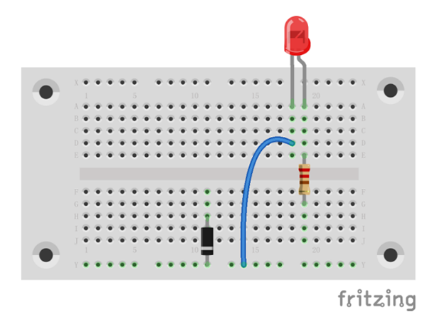
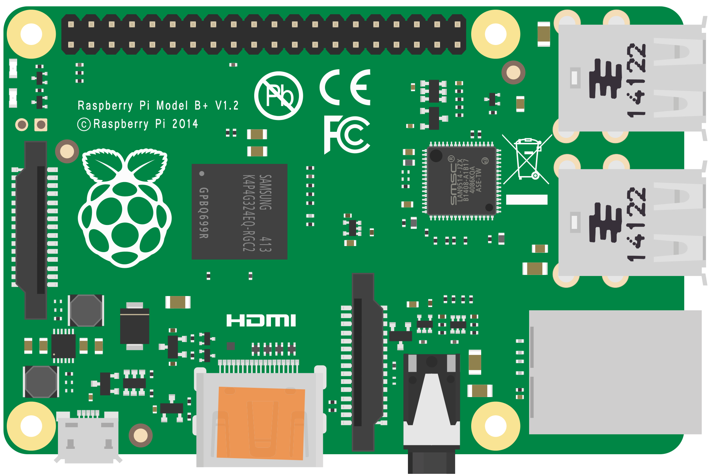
DATABASE:
Store data
Update data
Retrieve data

Slide 6
RPi Terminal:
sudo pip install firebase-admin

Slide 7
Back to laptop
Download “requirements.txt”
Move it to the root folder of your project folder (You can create one if you don’t have)
Open “Terminal” or “Command Prompt”
cd {folder containing requirements.txt}
pip install -r requirements.txt

Slide 8
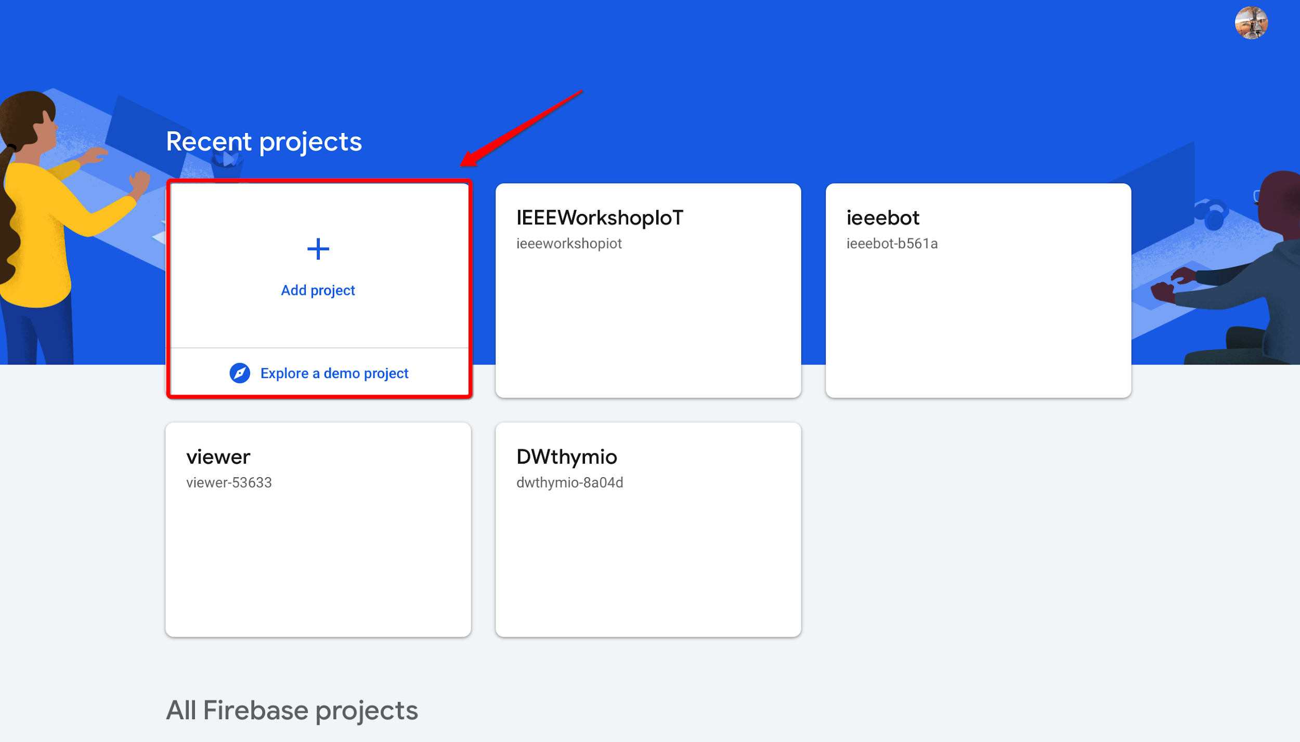

Slide 9
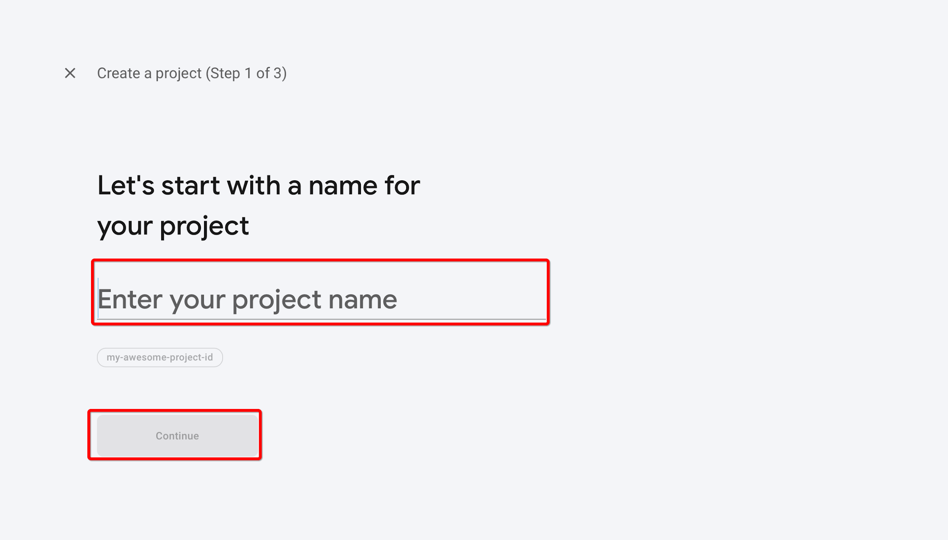

Slide 10
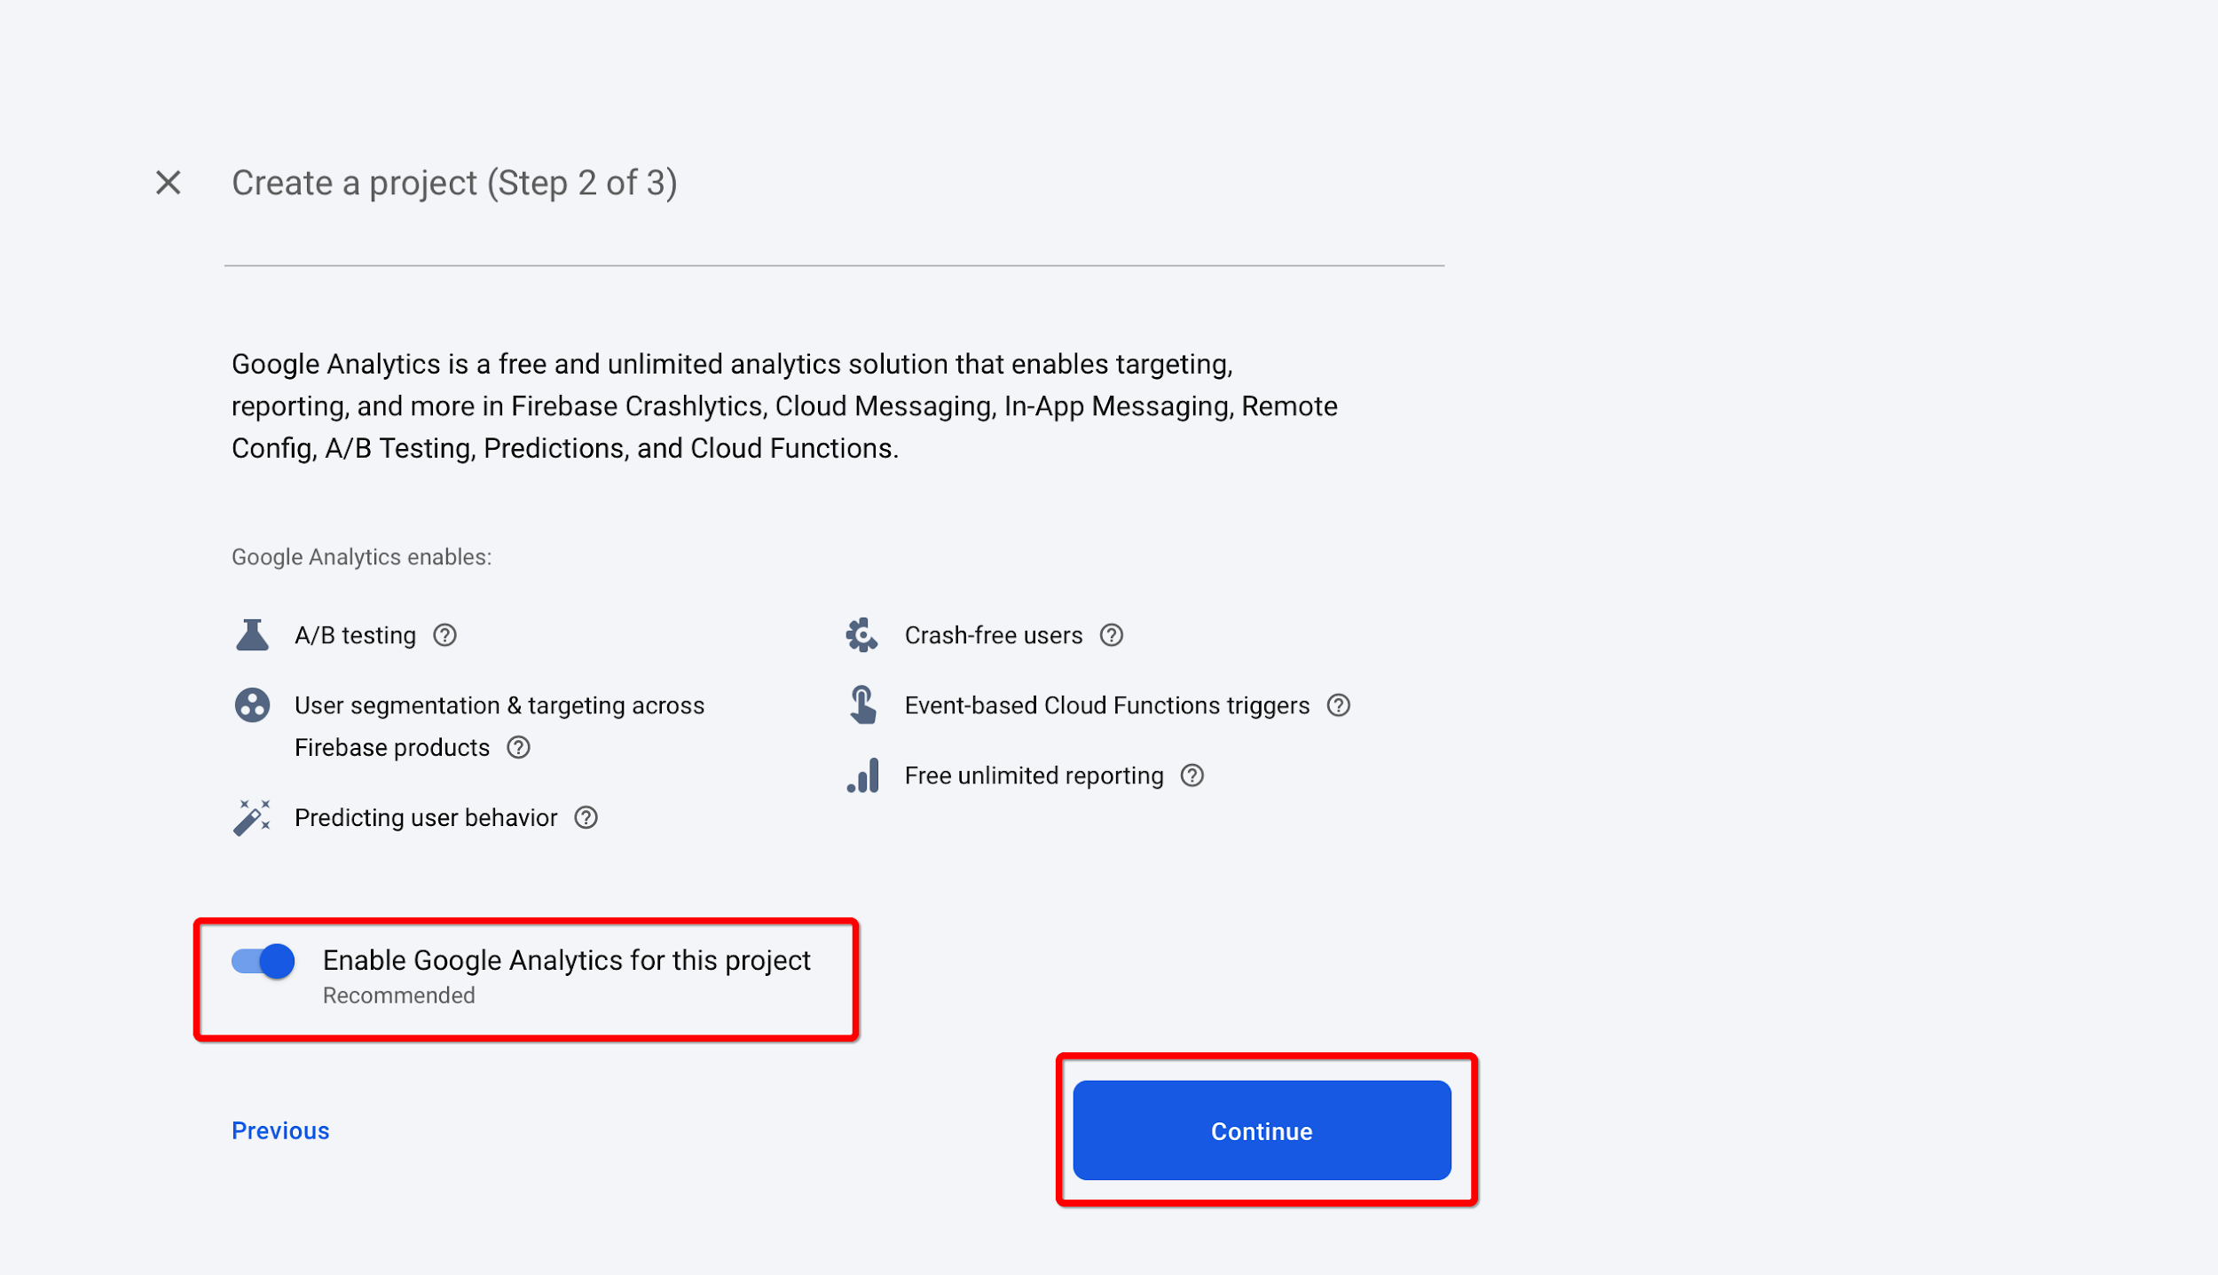

Slide 11
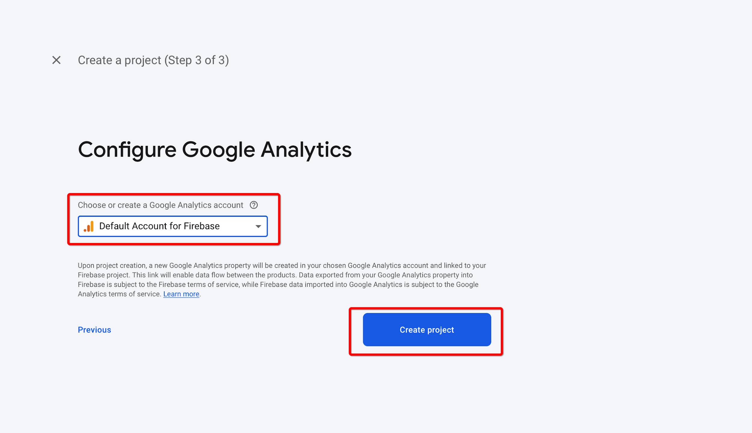

Slide 12
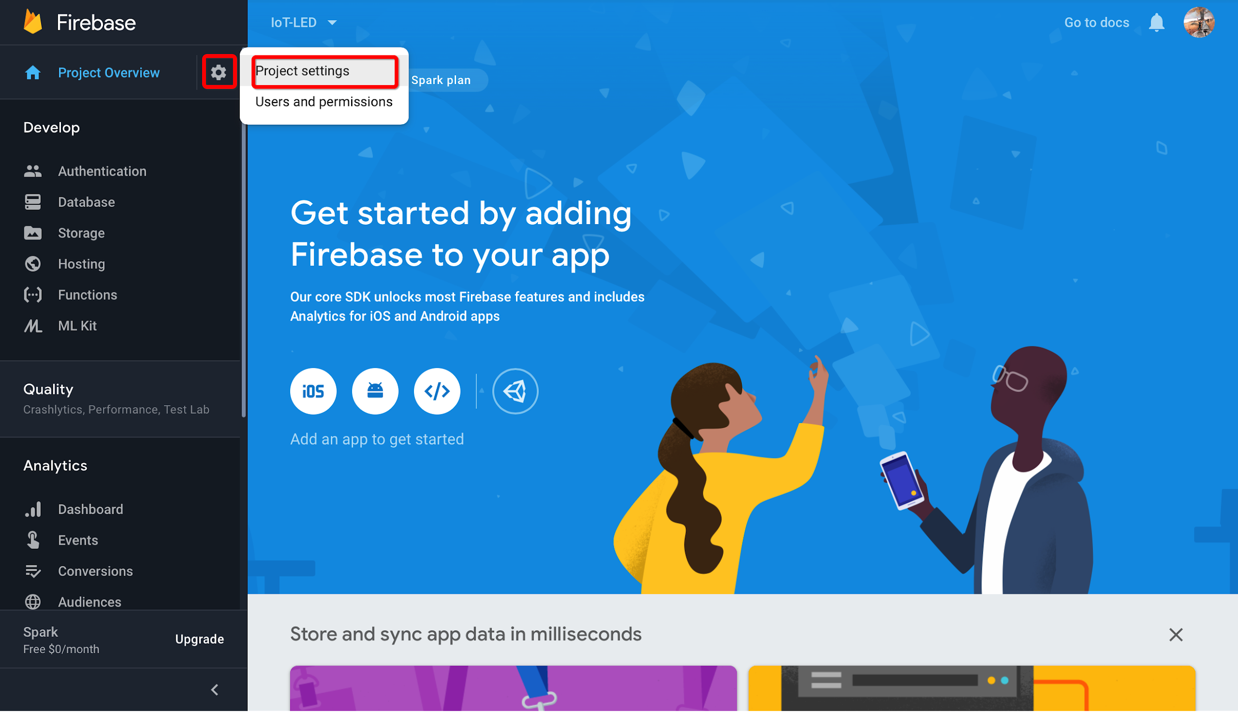

Slide 13
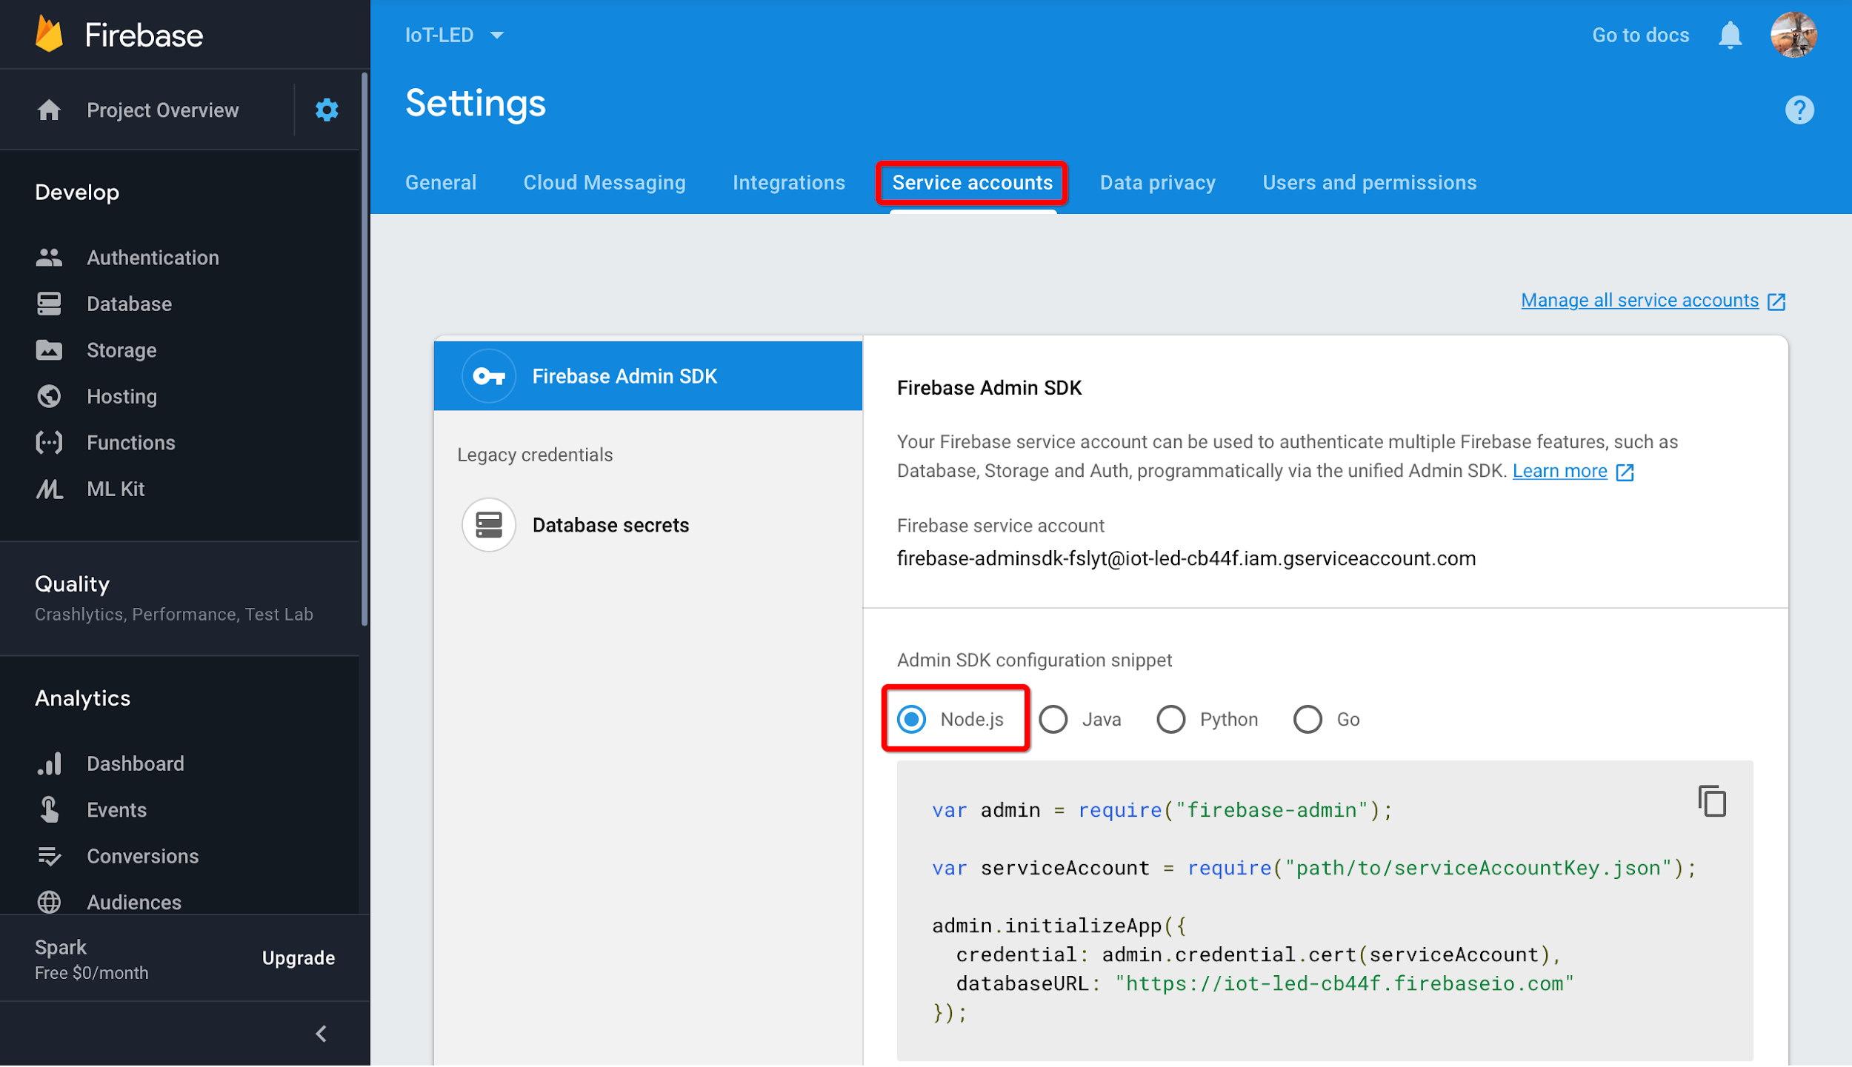

Slide 14
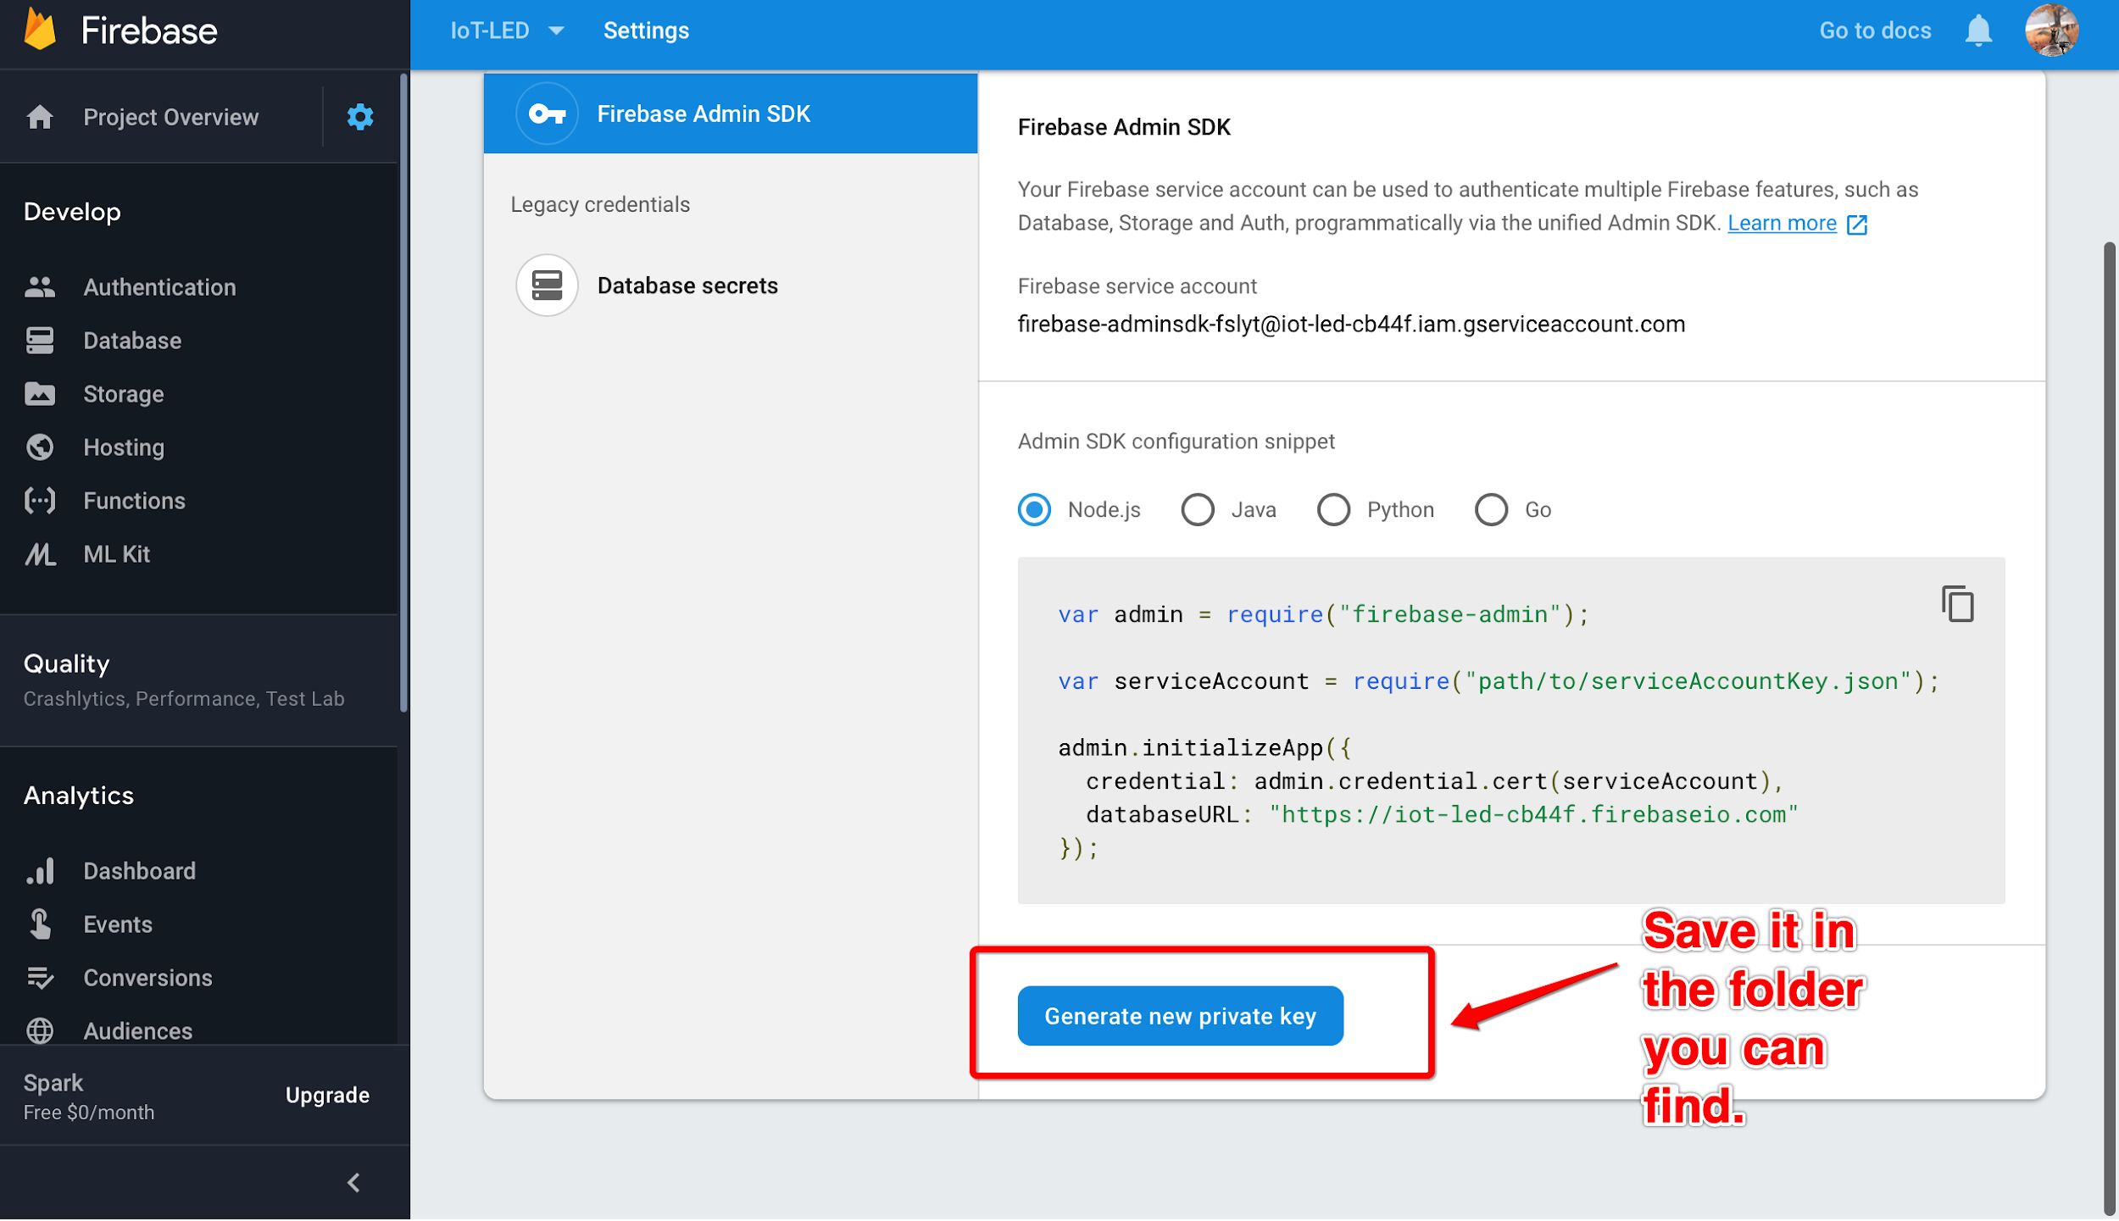

Slide 15
How to use credentials?
Rename the credentials file to name easy to remember (e.g. ieee.json)
Copy the file over to your RPi Desktop
Keep one file in your laptop as well

Slide 16
Google Firestore methods
import firebase-admin
from firebase-admin import credentials, firestore
creds = credentials.Certificate("{Your credentials filename}")
firebase = firebase_admin.initialize_app(creds)
db = firestore.client()

Slide 17
Google Firestore methods
db.collection(u’A’).document(u’a’)
collection A
document
document
document
document
a
b
c
d

Slide 18
update()
X = db.collection(u’A’).document(u’a’)
X.update(
{
“key”: value,
...
}
)

Slide 19
set()
X = db.collection(u’A’).document(u’a’)
X.set(
{
“key”: value,
...
}
)

Slide 20
delete()
X = db.collection(u’A’).document(u’a’)
X.delete() # delete document
# delete data fields
X.update(
{“key”: firestore.DELETE_FIELD}
)

Slide 21
get()
X = db.collection(u’A’).document(u’a’)
X.get().to_dict() # get data as a dictionary

Slide 22
What is a dictionary?
A = {
“Client1”: 500,
“Client2”: 1000,
“Client3”: 300,
...
}
# to access dictionary
# use the key
C1 = A[‘Client1’]
print(C1)
>>> 500
KEY
VALUE

Slide 23
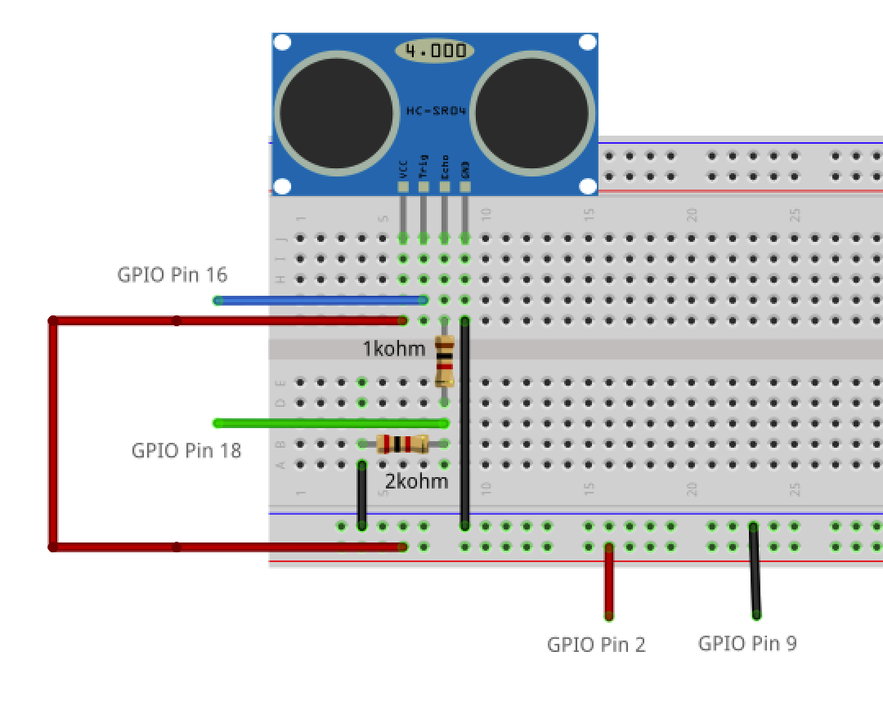
Connect the circuit!

Slide 24
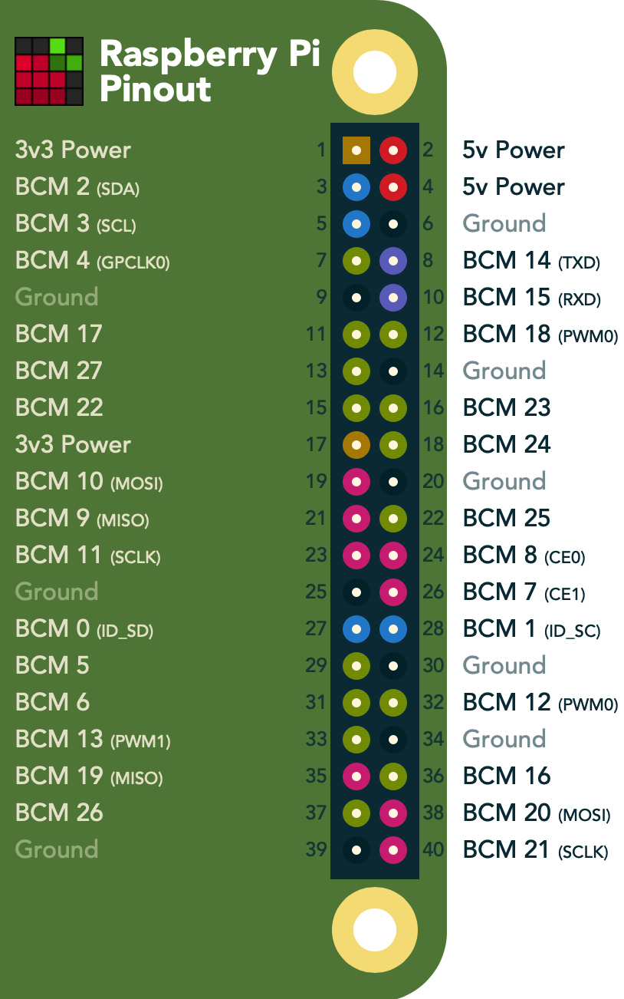

Slide 25
Let’s change a few lines of codes to link our device to our firebase!

Slide 26
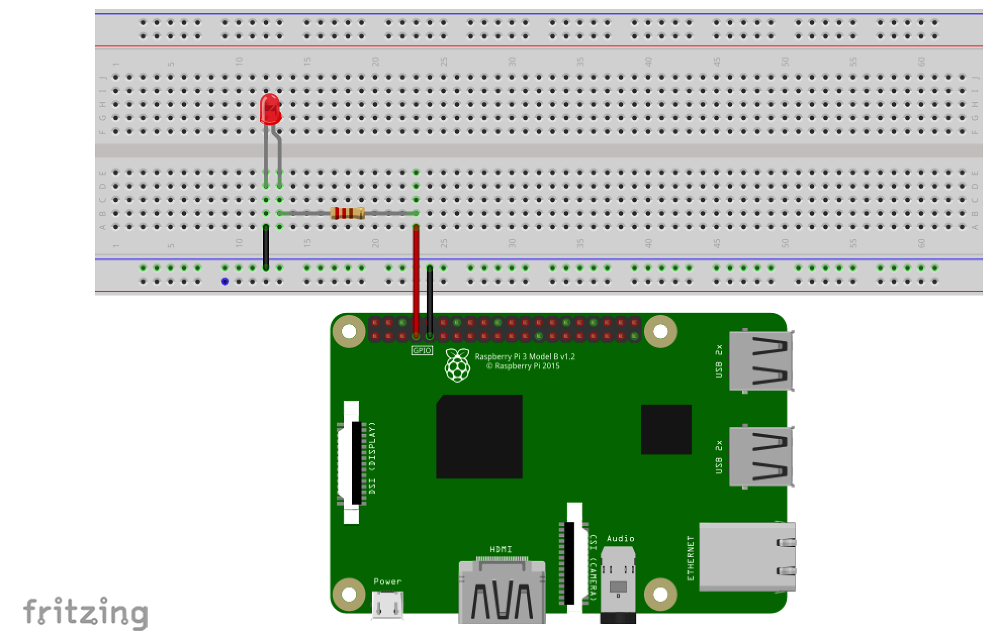
Activity 2: LED control

Slide 27
Let’s use Firebase to control the LED!

Slide 28

Python Flask
Micro-framework for web development in Python

Slide 29
Basic Flask routing
@app.route(‘/’)
def index():
return render_template(“index.html”)
app.run()

Slide 30
index.html
<!DOCTYPE html>
<html lang="en">
<head>
<meta charset="UTF-8">
<title>LED Control</title>
</head>
<body>
</body>
</html>

Slide 31
<!DOCTYPE html>
<html lang="en">
<head>
<meta charset="UTF-8">
<title>LED Control</title>
</head>
<body>
<h1> Hello World! </h1>
</body>
</html>

Slide 32
Your first Flask App!
Put “index.html” in folder “templates”
Make sure “templates” folder is in the same directory as your flask python file
Run flask python file

Slide 33
Make it more interesting with RPi!
Please follow live demo!
host = 0.0.0.0
Notes:
Change host to 0.0.0.0. Get IP address of the device. Access website from anywhere!!

Slide 34
End of workshop
Thank you all for coming!

